Slide 1
Smart College Companion
AI-Powered Student Portal
Department: Computer Science & Engineering
Project Type: Web Application
Student Name: B. Ravi Prakash
College Name: PBR VITS

Slide 2

The Challenge: Fragmented Academic Life
Multiple Platforms
Inefficient Management
Students navigate various systems for notes, attendance, and updates.
Managing academic information manually leads to wasted time and missed details.
Lack of Centralization
The absence of a single hub creates a disjointed and frustrating student experience.

Slide 3

Introducing the Smart College Companion
Our solution is a centralized, AI-powered web portal designed to streamline academic life.
Unified Access
A single point of entry for all academic resources and communication.
AI-Enhanced
Leveraging artificial intelligence for intelligent support and personalized experiences.
Modern Design
Intuitive and responsive web design for a superior user experience.

Slide 4

The Problem: Outdated Systems Hinder Learning
Scattered Resources
Manual Tracking
Notes, assignments, and announcements are spread across disparate platforms, making access cumbersome.
Time-consuming manual attendance methods are inefficient and prone to errors.
Delayed Assistance
Legacy Interfaces
Students often face delays in getting academic help, impacting their progress.
Existing systems are often clunky and not user-friendly, discouraging engagement.

Slide 5

Our Proposed Solution: A Unified Digital Ecosystem
The Smart College Companion brings together essential academic functions into one intuitive web portal.
Centralized Hub
1
One-stop access to notes, attendance records, and important notices.
AI Chatbot
2
Instant, intelligent support for academic queries and guidance.
Modern UI/UX
3
Responsive design ensures seamless access across all devices.

Slide 6

Market & Scope: The Future of Digital Learning
The demand for innovative educational technology is rapidly expanding, positioning our solution for significant impact.
Digital Learning Boom
The increasing adoption of online learning platforms creates a fertile ground for our portal.
Institutional Need
Colleges and universities require efficient systems for student management and engagement.
AI in Education
High demand for AI-driven tools that provide personalized academic assistance.
Broad Applicability
Potential for deployment in various educational settings, from colleges to e-learning platforms.

Slide 7
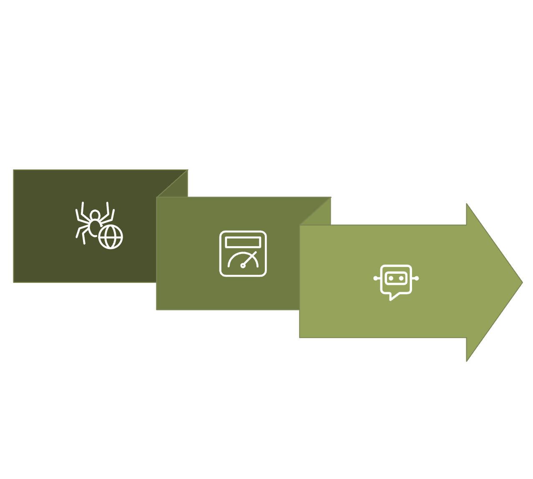
System Overview: How It Works
Our web-based application is designed for ease of access and intuitive interaction.
Web Access
AI Chatbot
Student Dashboard
Browser Accessible
Intuitive Dashboard
Available anytime, anywhere via any web browser.
Personalized student dashboard for quick overview and navigation.
Integrated AI Chatbot
Simplified Authentication
Seamless access to AI support within the portal itself.
UI-based authentication for a smooth and secure demo experience.

Slide 8






Core Modules: Building Blocks of the Companion
Home & Navigation
Student Dashboard
Login & Signup
Notes Management
AI Chatbot
Attendance Tracking

Slide 9






Technology Stack: Powering the Portal
Our choice of technologies ensures a robust, scalable, and user-friendly application.
Frontend Foundation
AI Integration
Development Tools
HTML, CSS, JavaScript for a dynamic and interactive user interface.
Chatbot (simulation/API-based) for intelligent interactions.
Lovable AI for efficient website building, Gamma AI for professional documentation and presentation.

Slide 10




Advantages & Future Vision
Key Advantages
Future Scope
1
Backend & Database
Centralized Management
Implementation for persistent data storage and retrieval.
Streamlines all academic activities into one platform.
Real-time Authentication
2
Advanced security features for robust user verification.
Time-Saving
Reduces administrative burden for students and faculty.
Personalized AI
Enhanced AI for tailored academic guidance and support.
3
User-Friendly
Intuitive design enhances the overall student experience.

